Slide 1
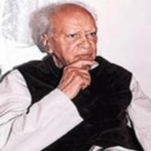
THE LOST CHILD
MULK RAJ ANAND

Slide 2
About the author:
Famous Indian writer and art critic was born in Peshawar in Punjab on December 12, 1905. He spent his early life in military camps. He was educated first at the Punjab University from where he graduated and then he went to England and studied Philosophy in London and Cambridge Universities. He was awarded the Ph. D. Degree by the London University for his original researches in Philosophy. While in England, he was for some-time, a lecturer in Philosophy and literature to the London County Council. He was, also on the staff of the B.B.C. and a film-script writer under the British Ministry of Information. He returned to India in 1929. He edited several magazines. Later, he became the editor of Marg, a famous art journal. He breathed his last on September 28, 2004.

Slide 3
Mulk Raj Anand’s story, The Lost Child narrates how a little boy was lost in the crowd of a village fair. It tells us how on his way to the fair he was attracted by various things such as toys, sweetmeat, balloons and birds, butterflies and flowers. But what attracted him most was the roundabout. It made him forget his parents and everything else in the world. Thus he lagged far behind his parents and got lost in the crowd of the fair. Here, Anand deals with the child psychology in a sensitive way without shying away from its reality.

Slide 4

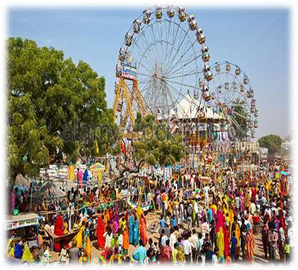

The Lost Child
It was spring time and the people
in colourful attire were going to the fair.
A Child along with his parents was going to the fair and was very excited & happy.

Slide 5
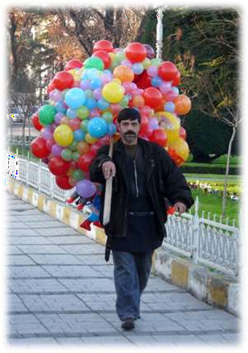
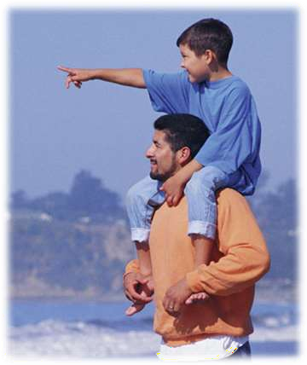

Slide 6
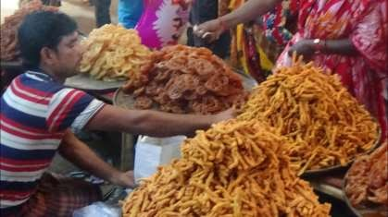
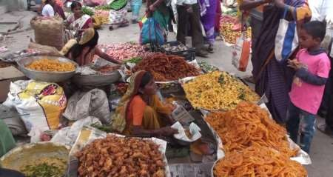
The Lost Child
The child was fascinated by the stalls of toys and sweets. Though his father got angry, but his mother pacified him and diverted his attention towards other things.

Slide 7
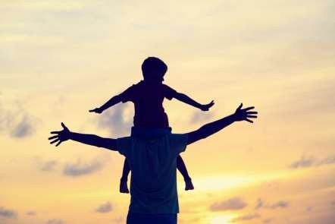

The Lost Child
The child moved forward but once again lagged behind because his
eyes were caught by one thing or the other every now & then.

Slide 8
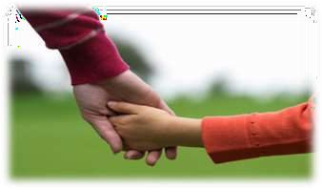
The Lost Child
As they moved forward, the child got demurred by the decorative items on the stalls. His mouth watered, seeing sweets decorated with gold and silver leaves.
“I want burfi” but he did not wait for his parents’ reply as he knew very
well that his parents will never agree to buy burfi for him.
They would say, he was greedy, therefore he kept moving.

Slide 9
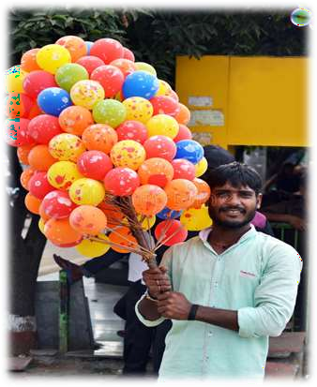
The Lost Child
Then he witnessed beautiful garlands
but didn’t ask for it.
Then he saw balloons, but he knew very well that his parents will say that he was too old to play with balloons, so he walked away.
Then he saw a snake charmer, a roundabout swing.

Slide 10
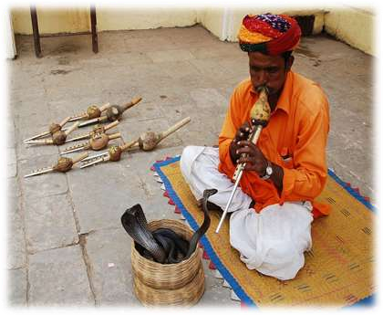
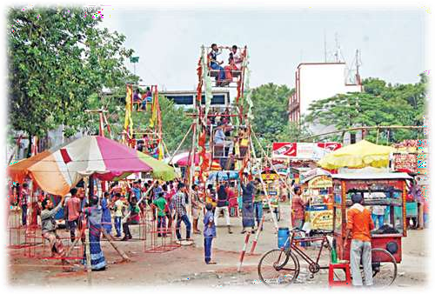
The Lost Child

Slide 11
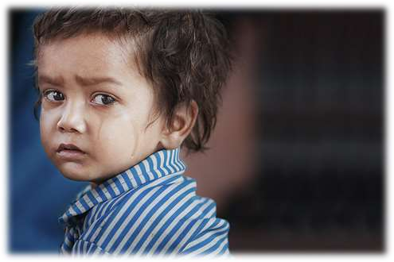
The Lost Child
Now he stopped to ask his parents the permission to enjoy the swing
but to his utter surprise, there was no reply.
Neither his father, nor his mother was there.
Now the child realized
that he was lost.
He ran here and there but with no fruitful result.

Slide 12
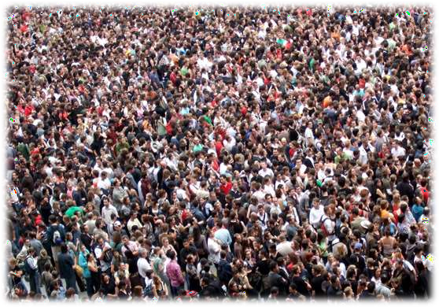
The Lost Child
He ran here and there but with no fruitful result. The place was too overcrowded.
He got terrified.

Slide 13
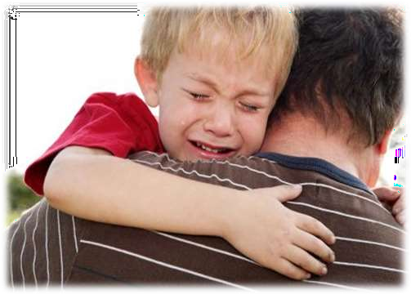
The Lost Child
Suddenly a kind hearted man took him up in his arms and tried to console him.
He asked him if he would like to have a joy ride.
But the child sobbed, “I want
my father, I want my mother”.

Slide 14

The Lost Child
The man offered him sweets, balloons and garland. But the child kept
on sobbing, “I want my father, I want my mother”.

Slide 15
The Lost Child does treat some very important issues. Central to it is humankind's responsibility to world outside. The episodes dealing with the stranded crowds en route to gala are exciting. They are handled realistically: Anand does not underplay the surging of the Indian crowd, and he definitely shows that trying to rescue them in order is a largely futile activity. Still, most of the characters in the story, including the narrator, are convinced that it is one's duty to try to fun and frolic them anyway.

Slide 16
When they had almost reached the fair, the child was attracted by the cries of a sweetmeat-seller. His mouth watered for the burfi which was his favourite sweet He knew that his desire would not be fulfilled , yet he spoke of it in a whisper then moved on without waiting for an answer The next attraction was the rainbow - coloured balloons but he was sure that he would be refused. Then they came to a snake-charmer who was playing on a flute before a snake. But the child had to pass on. The greatest attraction for the child came next. It was a roundabout in full swing. He watched it going round and round with a merry band of men, women, and children on it. As soon as it stopped he boldly asked his parents for the pleasure of a ride on the roundabout. But when he turned round he could not find them anywhere.

Slide 17
With a heart-rending cry of fear and grief, the weeping child ran about madly in search of his parents, but there was no sign of them. His turban came off and his clothes became wet with sweat and mud. Tired from running the little boy stood sobbing for some time and then started running again. This time he ran to a crowded temple. Desperately he ran through People’s legs, crying ‘mother, father’. At the door of the temple the crowd was so thick that he was knocked down and was about to be trampled when he was picked up by a man in the crowd. The man came out of the thick crowd with the boy and asked him whose baby he was, but the child only cried bitterly, saying that he wanted his father and mother. The kindhearted man tried to console the child by offering him a ride on the roundabout, but the child repeated his cry for his parents. The man next took him to the snake-charmer but he refused to listen to his flute; then he offered to buy him the bright-coloured balloons. Finally, the man tried to console him with some sweets, but all his efforts failed; the child only sobbed ‘I want my mother, I want my father.’

Slide 18
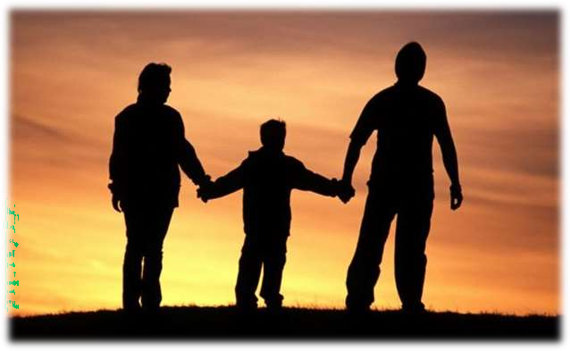
The End

